Slide 1
Introduction to Mind and Brain: Altered and Unusual States of Consciousness
Out-of-body and Near-Death Experience

Slide 2
General Introduction
In the following, we shall be looking at:
Near-death experiences (NDEs) and their proposed causes
Out-of-body experiences (OBES) and their causes
We shall be asking the question: Do these experiences provide evidence that consciousness continues after death or that consciousness can exist outside of the body?

Slide 3
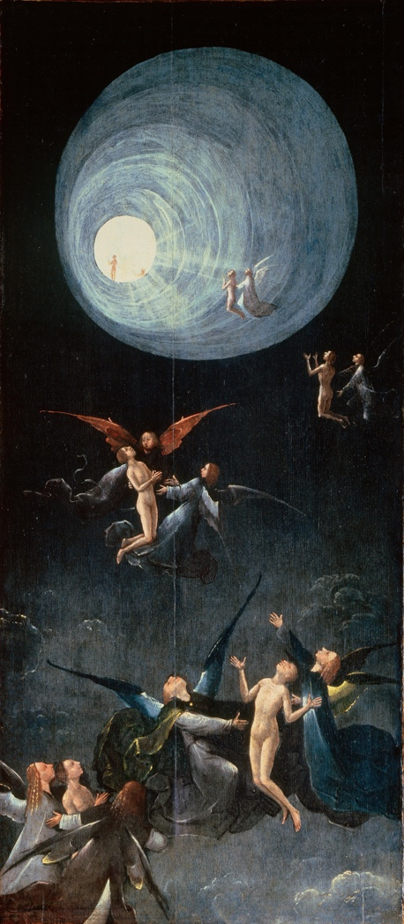
Near Death Experiences – An introduction
What is an NDE?
How often do they occur?
What is the phenomenology of an NDE? What is experienced?
How are people changed by an NDE?
What is the cause of an NDE?
Why do some researchers think they challenge the idea that the brain causes consciousness?

Slide 4
NDE - Definition
“…Any conscious perceptual experience that takes place during...an event in which a person could very easily die or be killed...but nontheless survives” (Moody, 1975)
“...A transcendental experience precipitated by a confrontation with death” (Irwin, 1999)
“NDEs are responses to life-threatening crises characterized by a combination of dissociation from the physical body, euphoria, and transcendental or mystical elements (Nelson et al., 2006)
“[NDEs] are profound subjective experiences with transcendental or mystical elements, in which persons close to death may believe they have left their physical bodies and transcended the boundaries of the ego and the confines of space and time” (Greyson, 2005)

Slide 5
NDE – How often do they occur?
Early studies of NDEs among cardiac arrest, traumatic accidents, suicide attempts and other life-threatening situations estimated an incidence of 48% (Ring, 1980) or 42% (Sabom, 1982)
Greyson suggested more likely to be between 9% and 18% (Greyson, 1998)
More recent research between 6% and 12% (Parnia et al., 2001; Greyson, 2003; Van Lommel et al. (2001)
Early studies show that age, gender, race, occupation, marital status, religiosity do not predict the probability of an NDE
Later studies show that young age is associated with a higher probability of NDES in cardiac arrest patients
Women have more intense NDE than men
Found in many different cultures and times (the specific phenomenology may vary across cultures)

Slide 6
NDEs – When do they occur? An example: Cardiac arrest
Cardiac arrest is a sudden stop in blood circulation due to the failure of the heart to contract effectively
Cerebral functioning shuts down within a few seconds
Full arrest leads rapidly to 3 major clinical signs of death – absence of cardiac output, absence of respiration, absence of brainstem reflexes
This is the best model we have of the dying process
Yet, in 5 published studies alone, over 100 cases of NDESs occurring under conditions of cardiac arrest have been reported (Greyson, 2003; Parnia et al., 2001; Sabom, 1982; Van Lommel et al., 2001)

Slide 7
NDEs – When do they occur? An example: Cardiac arrest (cont.)
NDE research seems to show that consciousness can be experienced during a period when the brain shows no measurable activity and all brain functions, such a brain stem reflexes, pupil reflexes, and respiration have ceased (Van Lommel, 2010)
During a cardiac arrest (a time when some patients report an NDE), loss of function in brain stem and cortex leads to unconsciousness within seconds
All brain stem reflexes have gone (no cornea reflex, gag reflex, pupils do not react to light
No blood flow in the brain
EEG studies show that activity in the cortex and deeper structures disappears completely
A flat EEG after a mean of 15 seconds
After about 6 seconds, oxygen deficiency sets in; wipes out connections between cortex, hippocampus, and thalamus
Neurons respond badly because they need glucose for energy

Slide 8
NDE - Phenomenology
Raymond Moody (1975) described 12 different NDE elements but stressed that most people only experience a few
1) the ineffability of the experience
2) a feeling of peace; pain is gone
3) the awareness of being dead
4) an out of body experience
5) a dark space – a tunnel experience
6) an unearthly environment
7) meeting with deceased persons, mostly relatives
8) seeing a brilliant light or being of light
9) panoramic live review
10) a preview of life yet to come
11) the perception of a border- people are aware that if they cross this border they wont be able to return to their body
12) the conscious return to the body, accompanied by great disappointment at having something so beautiful taken away

Slide 9
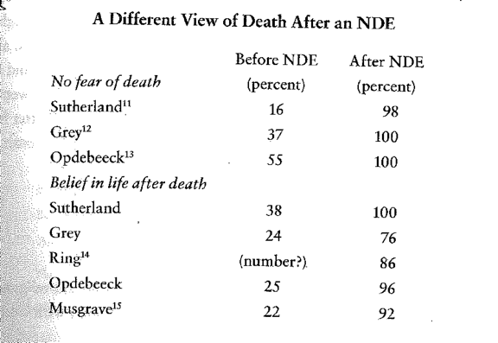
NDEs - Changed by a NDE (Van Lommel, 2010)

Slide 10
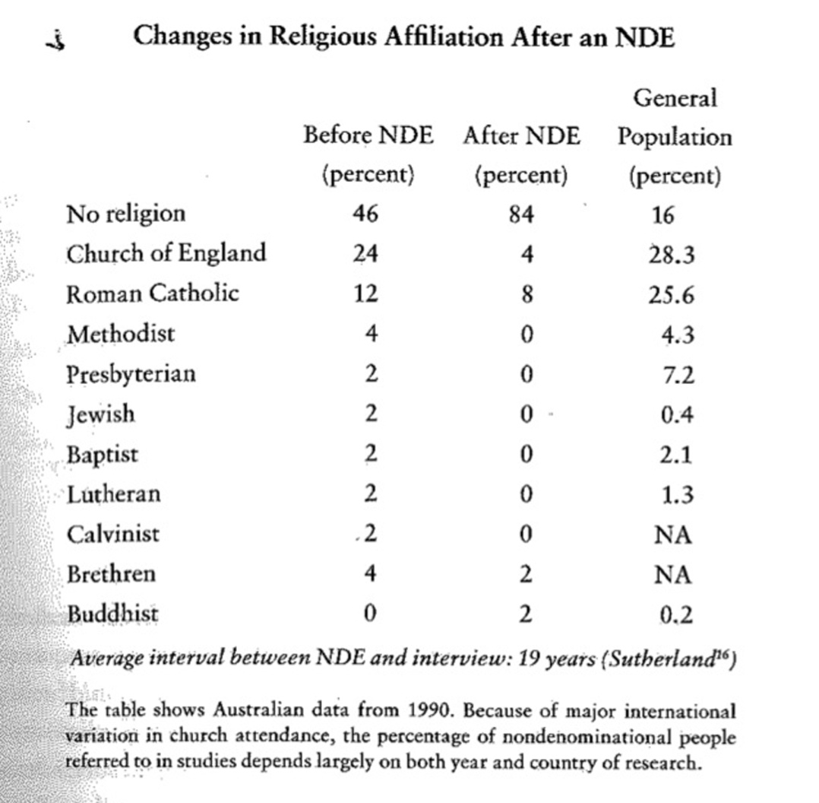
Changed by an NDE (Van Lommel, 2010)

Slide 11
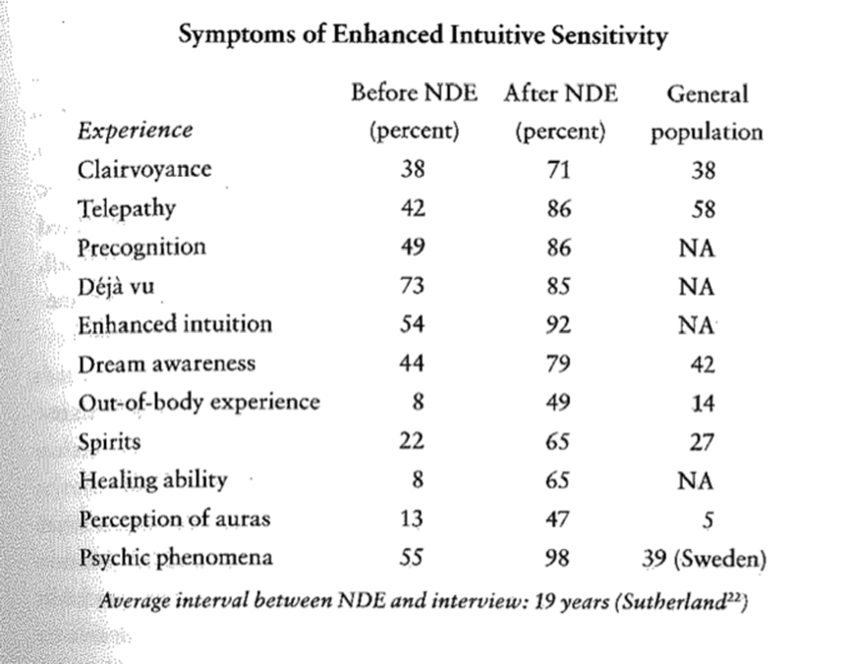
Changed by an NDE (Van Lommel, 2010)

Slide 12
Research into causes of NDEs: Why do they happen?
Physiological theories (anoxia, hypoxia, carbon dioxide overload)
Chemical reactions in the brain (ketamine, endorphins)
Neuroanatomical models (temporal lobe)
Psychological theories (fear of death, expectation, depersonalization, fantasy)
Objections to these theories

Slide 13
Research into causes of NDEs – physiological theories: Anoxia
Physiological theories about the cause and content of an NDE
Oxygen deficiency – when a cardiac arrest disrupts the flow of blood to the brain, the result is unconsciousness due to the total cessation of oxygen to the brain (anoxia)
In the case of oxygen deficiency in the brain (hypoxia), as seen in low blood pressure, heart failure, the result is not unconsciousness but confusion and agitation
Brain damage after waking from a coma is associated with confusion, fear, agitation, memory defects, and muddled speech
The most common explanation for NDE is oxygen deficiency in the brain – resulting in a brief spell of abnormal brain behavior and finally the loss of all brain activity. This results in the release of endorphins

Slide 14
Research into causes of NDEs – physiological theories: Anoxia (cont.)
Study of fighter jets used to explain NDEs
Having been placed in a centrifuge, they experience momentary oxygen deficiency in the brain when the enormous increase in gravity causes their blood to drop to their feet
Can experience elements that are reminiscent of an NDE (tunnel vision, light, peaceful sense of floating, images from the past, images of living people) but no reports of a life review, OBE, seeing deceased relatives – and no life transformations
However, an NDE is enhanced and lucid consciousness with memories
Also, it can be experience under circumstances where there is no oxygen deficiency – e.g. an imminent traffic accident or a depression
How to describe veridical OBEs with this too?

Slide 15
Research into causes of NDEs – physiological theories: Carbon dioxide overload
Carbon dioxide overload – along with oxygen deficiency comes carbon dioxide increase
Hungarian neurologist, Ladislas Meduna, asked people to breathe in carbon dioxide as a kind of treatment
Some experienced sense of separation from the body, bright light, a tunnel, peace, memory flashes
Images were rare, fragmented
Never involved a life review or encounter with deceased persons

Slide 16
Research into causes of NDEs – chemical reactions in the brain
Ketamine – drug used as an anesthetic; small quantity gives people sense of detachment from body; feelings one has died, communing with God (Jansen, 1997)
no known reports of life reviews, nor reports of positive changes
Endorphins – stress releases endorphins, which are morphines occurring naturally in the body; get rid of pain and cause sense of well being; but the effects last for several hours and the absence of pain and peace during an NDE vanish immediately after regaining consciousness

Slide 17
Research into causes of NDEs – Neuroanatomical Models
Some researchers propose a link between NDE and increased activity or the cessation of all activity in the temporal lobes
Under conditions of hypoxia and psychological stress, there is temporal lobe dysfunction and the release of endogenous neurotransmitters resulting in analgesia , euphoria, or feelings of detachment (Saavedra-Aguilar & Gomez-Jeria, 1989)
They claim “the list of mental phenomena seen in temporal lobe epilepsy and stereotoxic stimulation of the temporal lobe includes all the NDE phenomena”

Slide 18
Research into causes of NDEs – Neuroanatomical Models
Link between electrical stimulation studies of Wilder Penfield and NDEs?
Local electrical stimulation of the temporal lobes during brain surgery for epilepsy
Occasional memory flashes, experiences of light, sound, music (Penfield, 1955)
Not like NDE phenomenology; also, no veridical OBEs

Slide 19
Research into causes of NDEs – Psychological Theories
Fear of death – stress triggers a defense against imminent death
Expectations – what culture tells you to expect at death; differences between people in the West and in the East; in India differences between the north and south of the country
However, not so for many people; for many, the content of their NDE does not match their prior expectations of death
Children experience the same as adults

Slide 20
Research into causes of NDEs – Psychological Theories
Depersonalization – identity loss, sense of detachment, alienation, unreality; feel life is a dream; fear, panic, emptiness
Not the same as an NDE – people retain their identity, experience am enhanced reality; clear consciousness, lucid thoughts; potential OBEs.
Fantasies during OBEs – Susan Blackmore maintains that the content of an OBE is a combination of memories, fantasies, lucky guesses, and expectations
However, when heart patients without an NDE were asked to describe their resuscitation, they always made one or more errors, unlike patients who had an NDE during their resuscitation and were able to recall details of this procedure
Reports of OBEs are said to be reconstructions of perceptions made shortly before losing consciousness or immediately after waking; however, research has shown that people who wake from a coma have no memories of the period just before or after their period of unconsciousness

Slide 21
Research into causes of NDEs: Objections to these psychophysiological theories (Kelly, Greyson, & Kelly, 2007)
These theories fail to explain the enhanced consciousness, vivid sensory imagery, mental clarity, memories of the experience, “more real than real” sense
As Parnia and Fenwick point out: “any acute alteration in cerebral physiology such as occur in hypoxia…leads to disorganized and compromised cerebral function and impaired attention… NDEs in cardiac arrest are clearly not confusional and in fact indicate heightened awareness, attention and consciousness at a time when consciousness and memory formation would not be expected to occur”
NDEs seem to provide evidence for a type of mental functioning that varies “inversely, rather than directly, with the observable activity of the nervous system” (Myers, 1891)

Slide 22
Objections to these psychophysiological theories (Kelly, Greyson, & Kelly, 2007)
“Such evidence, we believe, fundamentally conflicts with the conventional doctrine that brain processes produce consciousness, and supports the alternative view that brain activity normally serves as a kind of filter, which somehow constrains the material than emerges into waking consciousness” (Kelly, Edwards, & Kelly, 2007)

Slide 23
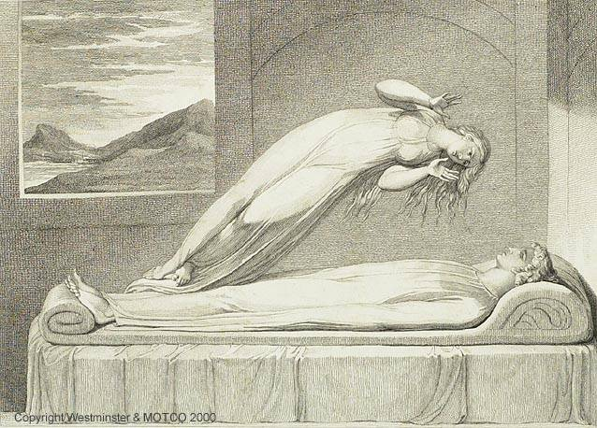
The Out-of-Body Experience – An introduction
What is an OBE?
How often do they occur?
What is the phenomenology of an OBE? What is experienced?
How are people changed by an OBE?
What is the cause of an OBE?

Slide 24
OBE - Definition
“We have defined an OBE by the presence of the following: … the feeling of being outside one’s physical body; the perceived location of the self at a distanced and elevated visuo-spatial perspective; and the experience of seeing one’s own body (autoscopy) from this elevated perspective” (Blanke & Dieguez, 2009)

Slide 25
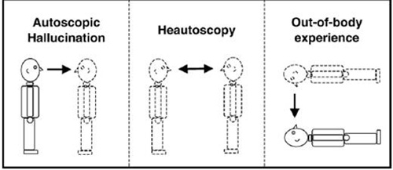
OBE - Definition
Different types of autoscopic phenomenon:

Slide 26
OBE - Incidence
Difficult to answer because:
1) Different researchers have asked different questions about the presence of an OBE
2) Different researchers have used different methods (e.g. telephone and personal interviews)
3) Most studies have been done on anglo-saxon college students
Overall, though, it seems that around 5% of the population have had an OBE

Slide 27
OBEs - Phenomenology
Important to distinguish from autoscopy hallucinations and heautoscopy
Subjects in OBEs report disembodiment, seeing the physical body from elsewhere, and vestibular and bodily sensations
Veridical OBEs

Slide 28
OBEs - Phenomenology
Blanke et al. (2004) describe experiences of six neurological patients
Examples:
Patient 1 (suffered from partial seizures that were characterized by an OBE): “Patient 1 felt as if she would be elevated vertically and effortlessly from her actual position associated with vertigo and fear. She saw herself (entire body as lying on the ground, facing up) and some unknown people (some were standing around her body, others were moving around) below. Initially, she felt as being `above her real body', but that she was rapidly rising higher. She felt as if her elevated body was in the horizontal position, but did not see any part of it. The visual scene always took place outdoors and was described as `a green meadow or hill'. The sensation of elevation continued and, quickly, she saw everything from so far away that she could not distinguish details anymore stating that she saw "something like a map of some country as you ®nd in geography books". Here, the elevation stopped and she fell back "to earth” (Blanke et al., 2004)

Slide 29
OBEs - Phenomenology
Patient 2 suffered from seizures
Patient 2: OBE (prior to operation). The patient was lying in bed and awakened from sleep, and the ®rst thing she remembered was "the feeling of being at the ceiling of the room". She "[1⁄4] had the impression that I was dreaming that I would ̄oat above [under the ceiling] of the room [1⁄4]". The patient also saw herself in bed (in front view) and gave the description that "the bed was seen from above" and that "there was a man and that she was very frightened". The scene was in colour, and was visually clear and very realistic. (Blanke et al. 2004)

Slide 30
OBEs – Non-visual phenomenology
(Blanke et al., 2004)
All OBE-patients experienced vestibular sensations characterized by feelings of fl̄ying or ̄floating
OBE/AS were associated with various emotions. Whereas fear was reported most often (Patients 1, 2a, 2b and 5), feelings of joy and elation were reported by Patient 4. For Patients 3 and 6 the experience was neutral, yet intriguing and surprising

Slide 31
OBEs – Phenomenology and Veridical OBEs
Veridical OBEs
Example : a woman in childbirth being out of her body and seeing her mother in the waiting room smoking a cigarette; according to the daughter, the mother (a non-smoker) admitted she had tried one or two because she was so nervous (Cook et al., 1998)
Example: the dentures (Van Lommel, 2001)
Example: the patient described leaving his body and watching the cardiac surgeon “flapping his arms as if trying to fly”. The surgeon verified this detail by explaining that, after scrubbing and to keep his hands away from possibly becoming contaminated before the surgery, he had developed the habit of flattening his hands across his chest, while rapidly giving instructions by pointing with his elbows (Cook et al., 1998)

Slide 32
Scientific Research into obes
Are they merely products of the brain?
We will look at some research and some cases studies…

Slide 33
RESEARCH: BLANKE ET AL., 2002 – SIMULATING OWN-BODY PERCEPTIONS
Research on locating the part of the brain that can induce OBES
Blanke et al. (2002). Simulating own-body perceptions: the part of the brain that can induce out-of-body experiences has been located. Nature, 419.

Slide 34
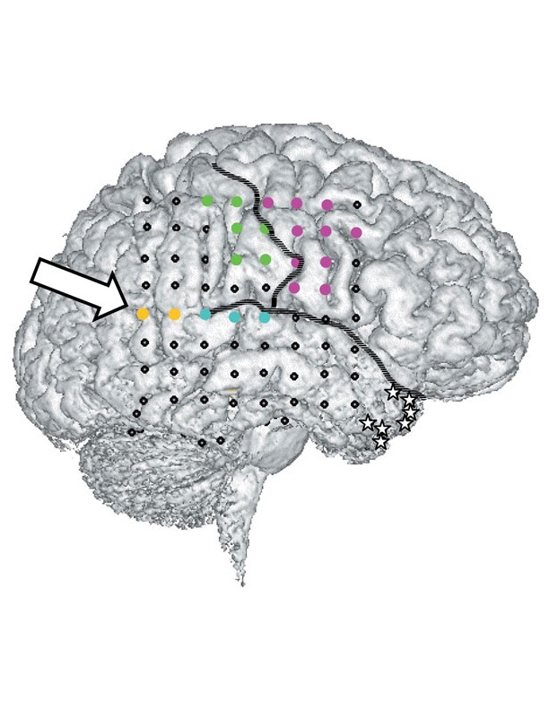
RESEARCH INTO CAUSES OF OBEs – blanke et al. (2002)
PROCEDURE:
Three-dimensional surface reconstruction of the right hemisphere of the brain from magnetic-resonance imaging. Subdural electrodes were implanted in the brain of an epileptic patient undergoing pre-surgical evaluation; the locations at which focal electrical stimulation (ES) evoked behavioral responses are shown: magenta, motor; green, somatosensory cortex; turquoise, auditory cortex.
Yellow, site at which out-of-body experience (OBE), body-part illusions and vestibular responses were induced (arrow). Stars indicate the epileptic focus in the medial temporal lobe. Informed consent was obtained from the patient and ES procedures conformed to the Declaration of Helsinki. Constant current (0.5–5.0 mA, 2-s train duration) was applied at 50 Hz in a bipolar manner through adjacent contacts4. Since undergoing a right anterior temporal lobectomy in 2000, the patient has been free of complex partial seizures.
Tempero -
parietal junction

Slide 35
RESEARCH INTO CAUSES OF OBEs – blanke et al. (2002)
“Stimulation at this site also elicited illusory
transformations of the patient’s arm and
legs (complex somatosensory responses)
and whole-body displacements (vestibular
responses), indicating that out-of-body
experiences may reflect a failure by the
brain to integrate complex somatosensory
and vestibular information.” (Blanke et al., 2002)
What is role of temporo-parietal junction?
“Initial stimulations (nǃ3; 2.0–3.0 mA)
induced vestibular responses, in which the
patient reported that she was “sinking into
the bed” or “falling from a height”. Increas-
ing the current amplitude (3.5 mA) led to
an OBE (“I see myself lying in bed, from
above, but I only see my legs and lower
trunk”). Two further stimulations induced
the same sensation, which included an
instantaneous feeling of “lightness” and
“floating” about two metres above the bed,
close to the ceiling.” (Blanke et al., 2002)

Slide 36
RESEARCH INTO CAUSES OF OBEs – blanke et al. (2002)
“The patient was then asked to watch her (real) legs during the electrical stimulation (n = 2; 4.0,4.5 mA). As before, she was lying down (upper body supported at an angle of 45 degrees, legs outstretched). This time, she reported seeing her legs “becoming shorter”.
“When asked to look at her outstretched
arms during the electrical stimulation
(nǃ2; 4.5, 5.0 mA), the patient felt as
though her left arm was shortened; the
right arm was unaffected. If both arms were
in the same position but bent by 90ᑻ at the
elbow, she felt that her left lower arm and
hand were moving towards her face (nǃ2;
4.5, 5.0 mA). When her eyes were shut,
she felt that her upper body was moving
towards her legs, which were stable (nǃ2;
4.0, 5.0 mA).”

Slide 37
RESEARCH INTO CAUSES OF OBEs – blanke et al. (2002): CONCLUSIONS
CONCLUSIONS: These observations indicate that OBEs and complex somatosensory illusions can be artificially induced by electrical stimulation of the cortex, the temporal parietal junction (the angular gyrus)

Slide 38
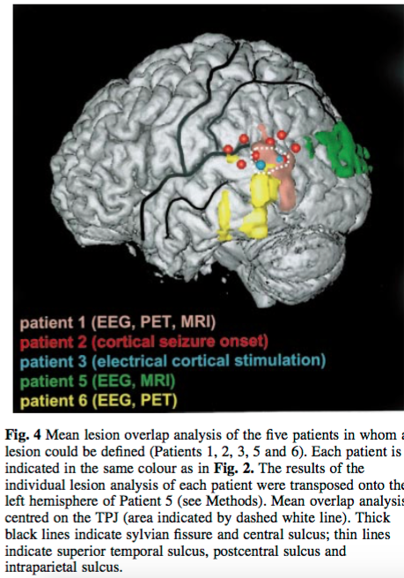
RESEARCH INTO CAUSES OF OBEs – blanke et al. (2004)
Study describes phenomenological, neuropsychological and neuroimaging correlates of OBE and AS in six neurological patients
Provides neurological evidence that both experiences share important central mechanisms.
Shows that OBE and AS are frequently associated with pathological sensations of position, movement and perceived completeness of one's own body. These include vestibular sensations (such as floating, flying, elevation and rotation), visual body-part illusions (such as the illusory shortening, transformation or movement of an extremity) and the experience of seeing one's body only partially during an OBE or AS
Finally, in five patients, brain damage or brain dysfunction is localized to the tempero-parietal junction (TPJ)
Association cortex
Suggests that OBE and AS are related to a failure to integrate proprioceptive, tactile and visual information with respect to one's own body (disintegration in personal space) and by a vestibular dysfunction leading to an additional disintegration between personal (vestibular) space and extrapersonal (visual) space.
Due to a paroxysmal cerebral dysfunction of the TPJ in a state of partially and briefly impaired consciousness.

Slide 39
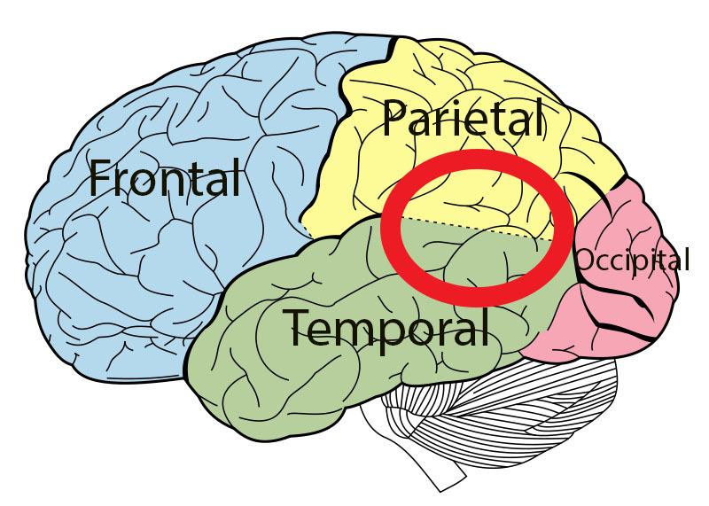
RESEARCH INTO CAUSES OF OBES – THE TEMPORO-PARIETAL JUNCTION (TPJ)
What occurs at the TPJ?
Incorporates information from thalamus and limbic system
Integrates information from visual system, auditory system, and somatosensory system
Integrates information from the external environment and internal environment
Important in self-other distinctions (theory of mind) (Saxe & Kanwisher, 2003)
TPJ creates central representation of one’s body – needs to integrate all information to do so (from auditory system, visual system, somatosensory system)
Sometimes discrepant information (conflicting information)

Slide 40
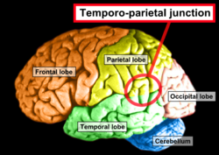
RESEARCH INTO CAUSES: MULTISENSORY DISINTRGRATION AT THE TPJ LEADS TO OBES (BLANKE ET AL., 2004; 2005)
“We speculate that, during AP, the integration of proprio- ceptive, tactile, and visual information of one's body has failed due to discrepant central representations by the different sensory systems. This might then lead to the experience of seeing one's body or body parts in a position that does not coincide with the felt position of one's body” (Blanke et al., 2004)

Slide 41
What do you think?
Does this data show that brains cause OBES?
Does it explain OBEs?
Does it show that OBEs are nothing other your brains?

Slide 42
A study: The AWAreness in Resuscitation study (AWARE) (Parnia et al., 2014)
The largest study of what happens when we die and attempt to verify OBEs
Does consciousness survive death?
Four year pursuit across 25 hospitals in the US, Canada, and Europe
Focused on cardiac arrest patients
9/140 patients who survived reported NDEs and 2 of these reported explicit awareness during a period of apparent death One was verified)
Test of veridical OBE – placards placed on shelves above bed. Can patient report what is on the placard?

Slide 43
A study: The AWAreness in Resuscitation study (AWARE) (Parnia et al., 2014)
Verified OBE
During the NDE, the patient felt quite euphoric.
The patient heard an automated voice saying "Shock the patient, shock the patient."
The patient rose near the ceiling and looked down on his physical body, the nurse and another man, bald and "quite a chunky fella", who wore blue scrubs and a blue hat. The patient could tell the man was bald because of where the hat was.
The next day, the patient recognized the bald man who attended him during the resuscitation.
The medical record confirmed the use of an AED (Automated External Defibrillator) that would give the automated instructions the patient heard and the role that the identified man played during the resuscitation.

Slide 44
A study: The AWAreness in Resuscitation study (AWARE) (Parnia et al., 2014): CONCLUSIONS
What do the authors conclude from this one case that was validated:
“This is significant, since it has often been assumed that [these] experiences ... are likely hallucinations or illusions, occurring either before the heart stops or after the heart has been successfully restarted, but not an experience corresponding with 'real' events when the heart isn't beating. In this case, consciousness and awareness appeared to occur during a three-minute period when there was no heartbeat. This is paradoxical, since the brain typically ceases functioning within 20-30 seconds of the heart stopping and doesn’t resume again until the heart has been restarted. Furthermore, the detailed recollections of visual awareness in this case were consistent with verified events.
“Thus, while it was not possible to absolutely prove the reality or meaning of patients’ experiences and claims of awareness, ... it was impossible to disclaim them either and more work is needed in this area. Clearly, the recalled experience surrounding death now merits further genuine investigation without prejudice."

Slide 45
A case study – Pam Reynolds
Exemplifies numerous features difficult to account for in conventional psychophysiological terms
Reported by Sabom (1998), a cardiologist, who was able to obtain verification from medical personnel concerning details of the operation that the patient underwent during her operation
http://www.youtube.com/watch?v=WNbdUEqDB-khttp://www.youtube.com/watch?v=osfIY4B3y1U&feature=related

Slide 46
A case study – Pam Reynolds: Conclusions
Not a perfect case
Details not published for several years after
The verifiable events that she reported observing in the operating room occurred when she was anesthetized and sensorially isolated but before and after the period of time in which she was clinically dead (that is, they occur from when her skull was opened; at this time she was still alive)
Impossible to tell exactly when she had the experience of going into a tunnel, seeing the light, conversing with her relatives
Her description of the experience suggests that is was continuous from when she first heard the surgeon’s saw (an hour after she had been anesthetized) until she returned to her body and heard the song “Hotel California” some 5 hours later
Cannot say with certainty that any of her NDE occurred during the period she was clinically dead
“Even so, the extremity of her condition and her heavily anesthetized state throughout the entire procedure casts serious doubt on any view of mind or consciousness as unilaterally and totally dependent of intact physiological functioning” (Kelly, Greyson, & Kelly, 2007)

Slide 47
The challenge of NDEs and OBEs (Kelly, Greyson, & Kelly, 2007)
“The challenge lies in recognizing and accounting for one central feature that in our opinion makes this phenomenon uniquely important in the mind –body problem – specifically, the occurrence of vivid and complex mentation, sensation, and memory under conditions in which current neuroscientific models of the mind deem conscious experience …impossible” (Kelly, Greyson, & Kelly, 2007)
“The paradoxical occurrence of heightened, lucid awareness and logical thought processes during a period of impaired cerebral blood flow raises perplexing questions for our current understanding of consciousness and its relation to brain function. As prior researchers have concluded, a clear sensorium and complex perceptual processes during a period of apparent clinical death challenge the concept that consciousness is localized exclusively in the brain (Greyson, 2003)

Slide 48
The challenge of NDEs and OBEs
How might scientists intent upon defending the conventional view respond?
1) even in the presence of flat-lined EEG there could still be some brain activity going on
However: “The issue is not whether there is brain activity of any kind whatsoever, but whether there is brain activity of the specific form regarded by contemporary neuroscience as the necessary condition for conscious experience” (Kelly, Greyson, & Kelly, 2007)
Activity of this sort is abolished both by cardiac arrest and general anesthesia
In cardiac arrest, action potentials, the physical basis for any possible coordination of neuronal activity between widely separated regions, are abolished
Moreover, cells in the hippocampus (thought to be essential for memory formation) are vulnerable to anoxia

Slide 49
The challenge of NDEs and OBEs
“In short, it is not credible to suppose that NDEs occurring under conditions of general anesthesia, let alone cardiac arrest, can be accounted for in terms of some hypothetical residual capacity of the brain to process and store complex information under these conditions” (Kelly, Greyson, & Kelly, 2007)

Slide 50
WATCH!
http://www.closertotruth.com/series/there-life-after-death#video-4190
https://youtu.be/mD7NzrBgXwM

